Slide 1


7th International Conference on Knowledge Innovation and Invention 2024 (ICKII 2024)
August 16-18, 2024
Enhanced Comparative Analysis of Pretrained and Custom Deep Convolutional Neural Networks for
Galaxy Morphology Classification
Tram Le, Thu Nguyen, Nickson Ibrahim Makama, Thanyaporn Noiplab
Jungyoon Kim, Deepshikha Bhati
Department of Computer Science,
Kent State University, Kent, Ohio, USA

Slide 2

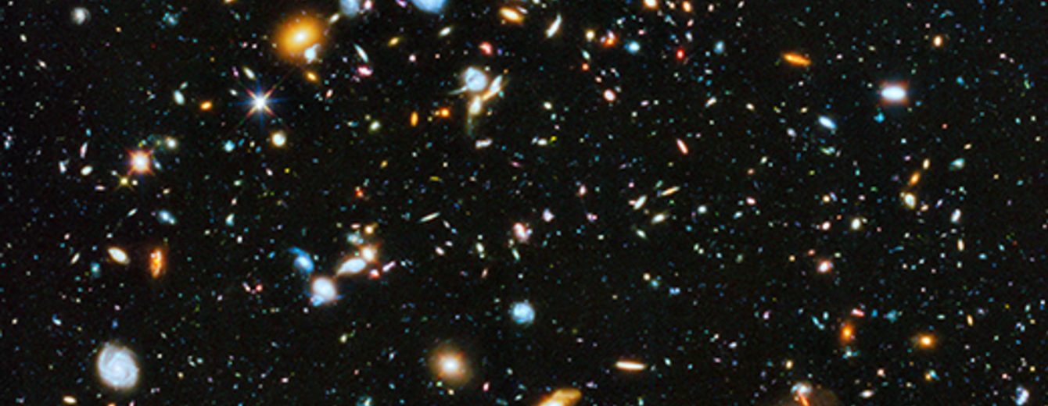
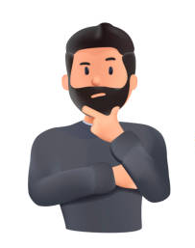
Introduction
Classifying galaxy morphology stands as one of the most formidable challenges in astrophysics, demanding advanced techniques to unravel the complexities of the universe's diverse and intricate structures.
Variability in Galaxy Images
Vary tasking for humans
colorful deep space images
from NASA, ESA, H. Teplitz and M. Rafelski (IPAC/Caltech), A. Koekemoer (STScI), R. Windhorst (Arizona State University), and Z. Levay (STScI)
Objectives
Utilize CNNs to classify Galaxy by there Morphology; more accurate & efficient
Develop and compare three models: a Custom-Built CNN, ResNet50 model initialized with random weights and pretrained EfficientNet_B5 model utilize transfer learning
Notes:
Hi Tanya, this is the more simple script for the intro, easier for u to speak: The problem such that the Traditional methods of galaxy classification relied heavily on observation through telescopes, process not only time-consuming but also high computationally require. These tasks are challenging for human perception
To address these challenges, we utilize deep convolutional neural net analyze and enhance the classification process with 3 models…..

Slide 3
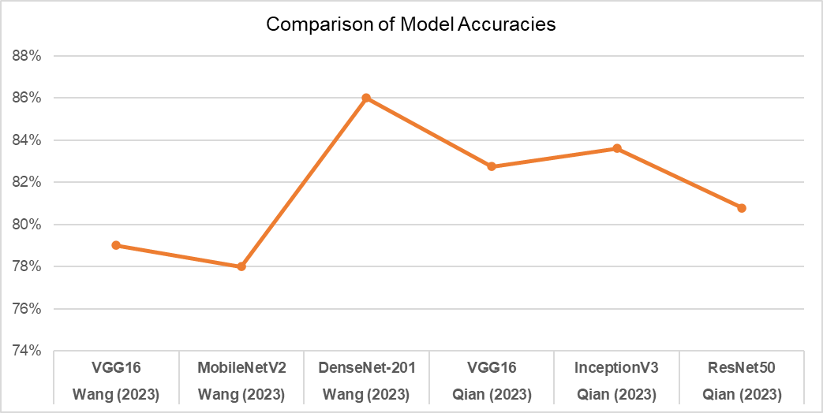

Related Work on the Galaxy10 DECals
Workflow
Data
Exploration and Preparation
Model Analysis
Training and Finetune
Evaluation
Name(s) of Author (Year) and Research Title | Limitations/Cons
Qian, Y. (2023, September), Performance comparison among VGG16, InceptionV3, and resnet on galaxy morphology classification | The total parameters of InceptionV3 are about 25 million, which makes it challenging to maintain its remarkable computational efficiency
Wang, G. (2023, September), Galaxy morphology classification with densenet | DenseNet-201 had a longer training time due to its larger model size
Understand the data and prepare it for effective modeling
Tailoring CNN Architectures and Transfer Learning
Develop a model capable of making accurate classification
Assess the model's performance with different metrics
Notes:
and when u talk about the workflow, make sure mention each part in the small script as well

Slide 4
01
Data

Slide 5
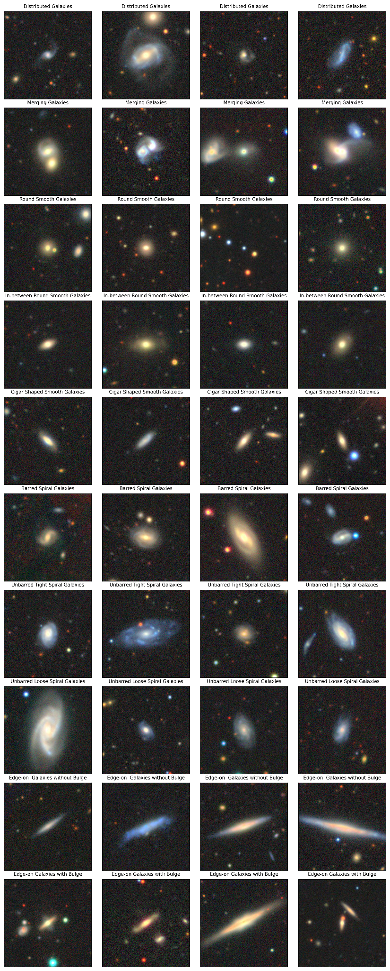
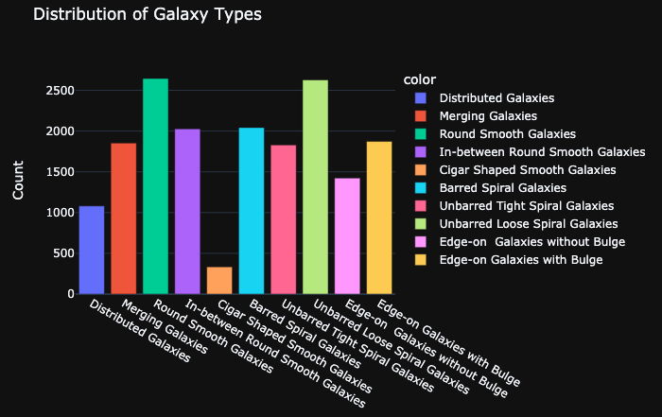
Dataset and Exploration
Galaxy10 DECals with the size 2.74GB
Included 10 classes
17, 736 colored images (256 x 256 x 3)
Each row images represent each class of galaxy
Notes:
Address the noise that exist in the dataset

Slide 6
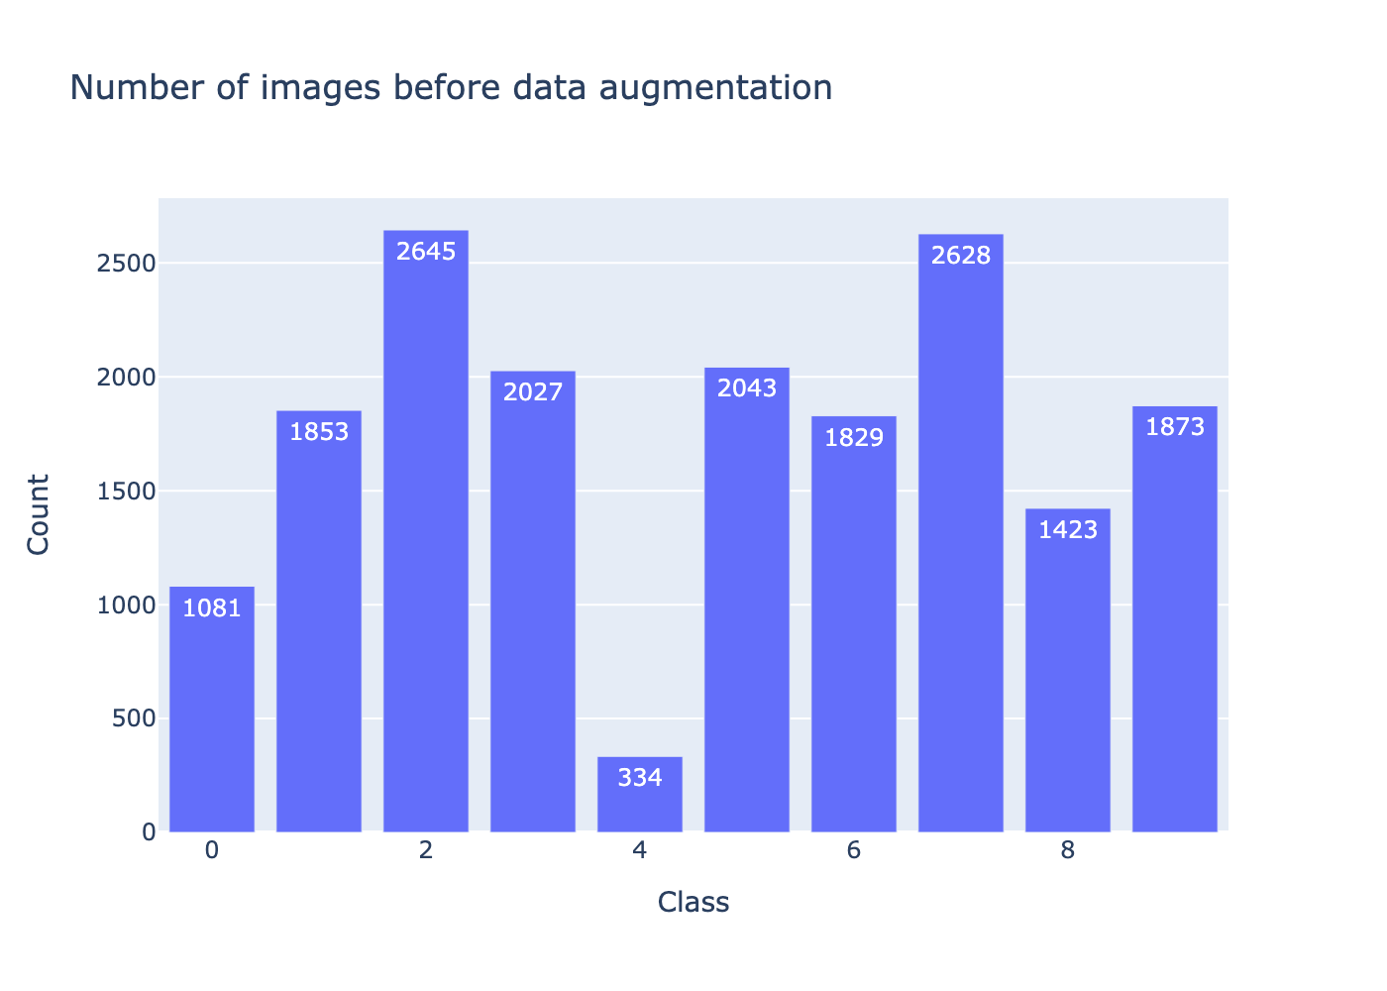
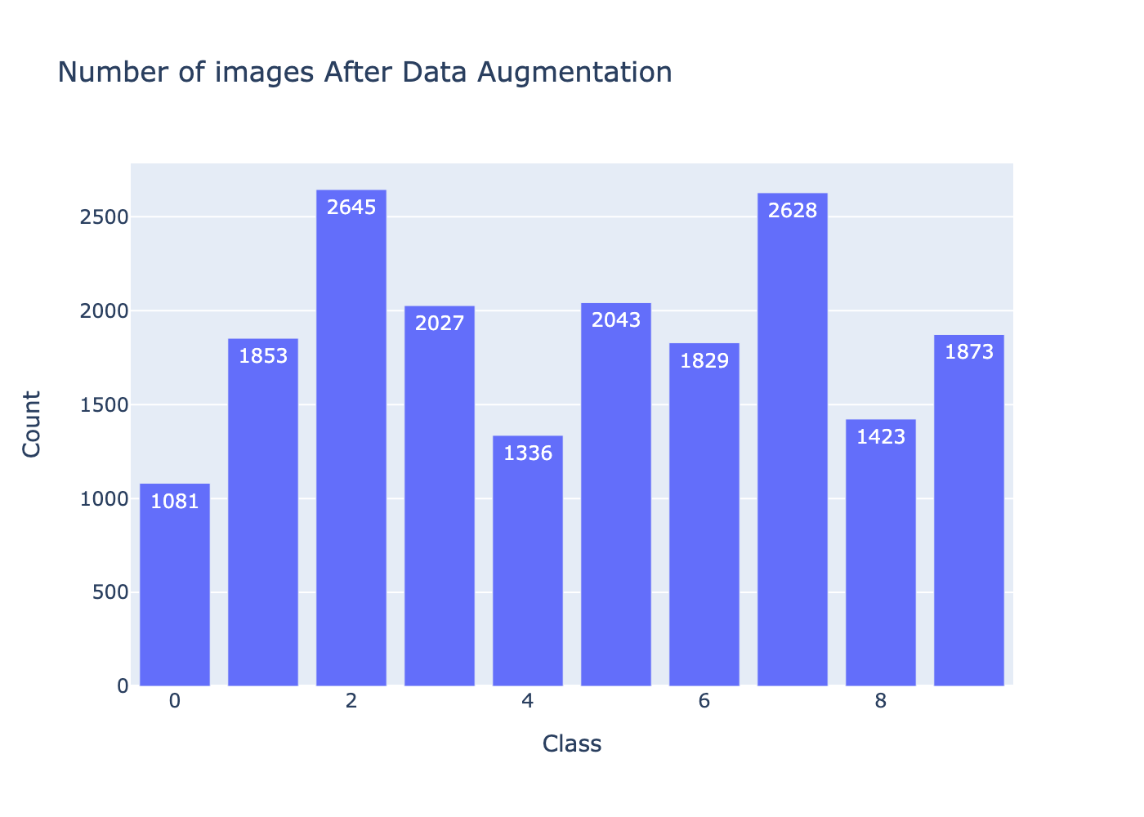
Data Preprocessing
Increase Accuracy:
+2~4%
Class Balancing
Before
After
Class Distribution of Images

Slide 7
Data Preprocessing [Cont.]
Augmentation and Normalization:
Standardized image by scaling pixel from 0-255 to 0-1.
Normalized each channel to a mean of 0 and a standard deviation of 1. This approach promotes faster convergence and improves accuracy
Experimented with different combinations of data augmentation
Name | Effect
Resize Images | ­­↑ 4% Accuracy
Rotation | ↑ 2% Accuracy
Horizontal Shift | ↑ 2% Accuracy
Vertical Shift | ↑ 1% Accuracy
Horizontal Flip | ↑ 2% Accuracy
Zoom in/out | ↑ 1% Accuracy
Color Jitter | ↑ 2% Accuracy
Trivial Augment Wide | ↑ 3% Accuracy
Increase Accuracy:
+15~17%

Slide 8
02
Models

Slide 9
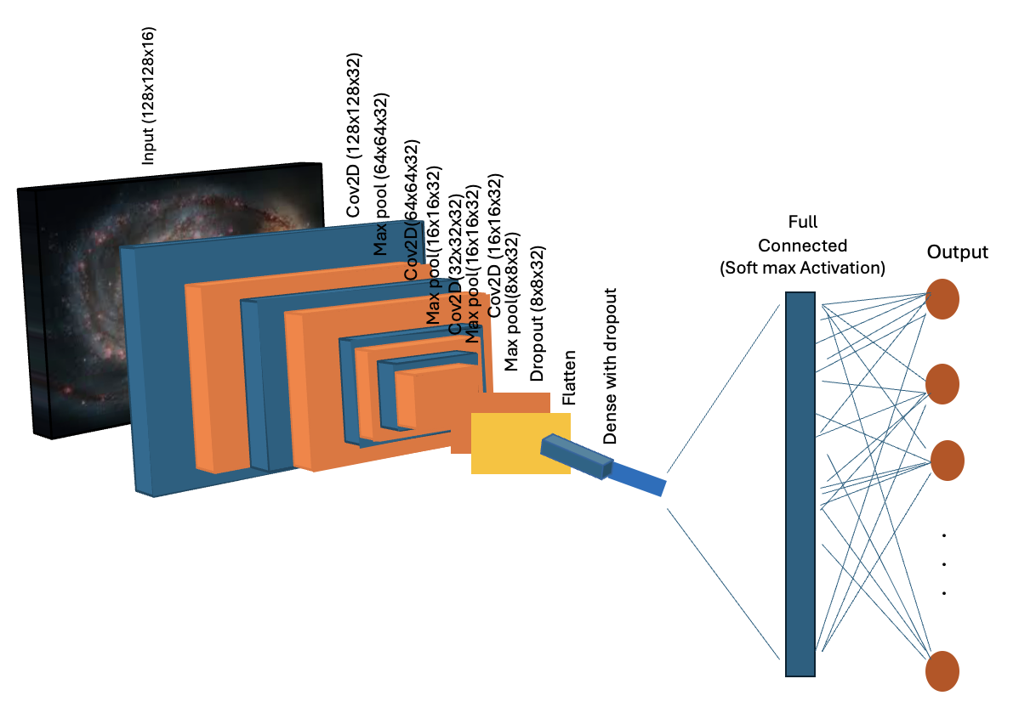
Model 1: Custom-Built CNN
A foundational approach, utilizing convolutional layers to analyze image features
Split 80% for training and 10% for validation and 10% for testing
Using sequential layer stacking:
Input layer
4 Convolutional Layers: with Tanh activation function:
Layer 1: 16 filters of size (3, 3)
Layers 2, 3, and 4: 32 filters of size (3, 3)
Max Pooling size 2
Dropout Layers: 0.25 and 0.5
Flatten Layer
Fully Connected Layer: with 32 neurons followed by activation function
Output Layer: Using Softmax for Outputs a probability distribution

Slide 10
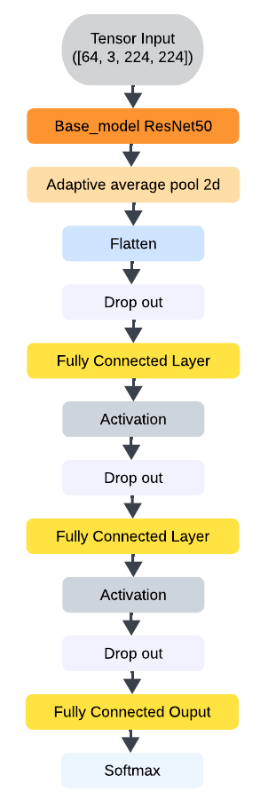
Model 2: Tailored ResNet50
Utilize the ResNet50 architecture as the base model without relying on pre-trained weights.
Then tailor with the Model 1
On split 80% for training and 20% for testing
Feature extraction by truncated ResNet (remove the final layer of ResNet50)
Adaptive Average Pooling with size 1
Drop out rate: 0.5
Three Fully Connected Layers: 512, 128 and 10 neurons which corresponds to the 10 classes in classification task
Using ReLU as activation function

Slide 11
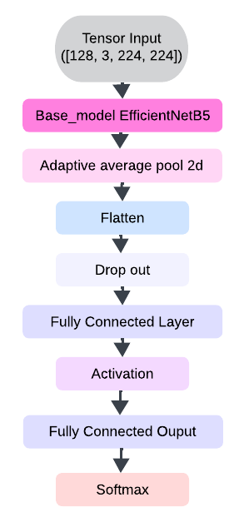
Model 3:
Transfer Learning-EfficientNetB5
Adopts transfer learning techniques to enhance performance with pretrained weight
Inhere from the Model 2
Split 80% for training and 20% for testing
Feature extraction by freeze the early layers of EfficientNet_B5 so that their weights are not updated during the new training process
Only Fully Connected Layers: 225, 10 neurons
Also, using ReLU as activation function

Slide 12
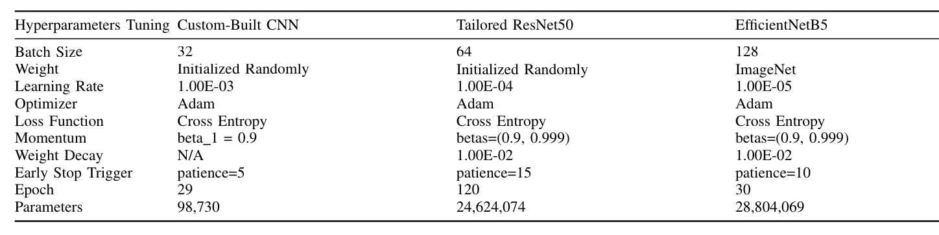
Models: Fine-tuned and acceleration
Utilizes a Tesla V100 GPU and NVIDIA A100 GPU to train
Training durations exceeded 20 minutes, 1 hour, and 30 minutes respectively for each model
Utilize mixed precision training with autocast() and scale the loss with GradScaler() to improve computational efficiency, reduce memory usage and stability of gradients
Table 1. HYPERPARAMETERS TUNING FOR DIFFERENT MODELS

Slide 13
03
Evaluations

Slide 14
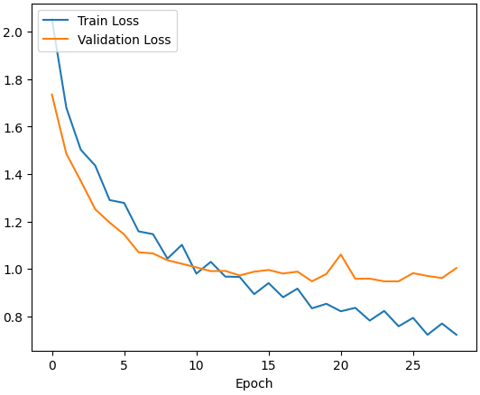
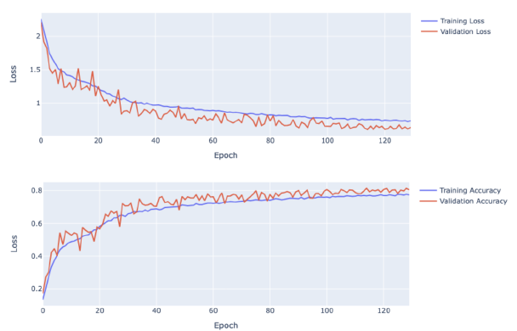
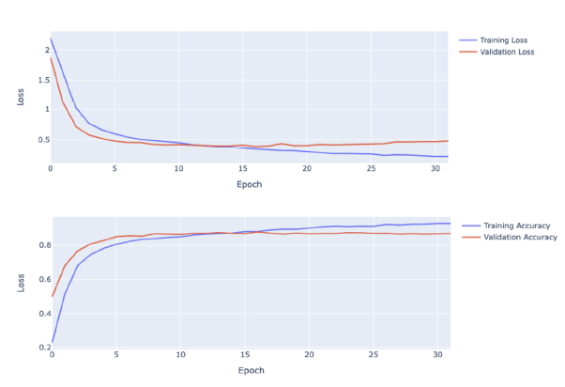
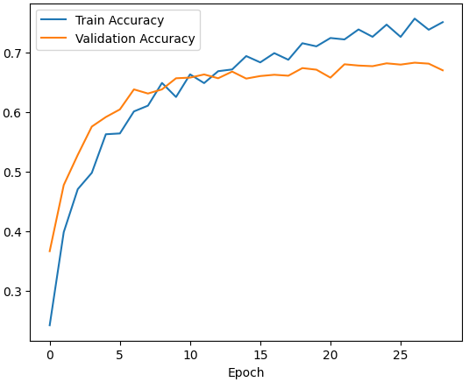
Results: Loss and Accuracy Curves
Custom Model: 70%
RestNet50: 80%
EfficientNet_B5: 87%

Slide 15
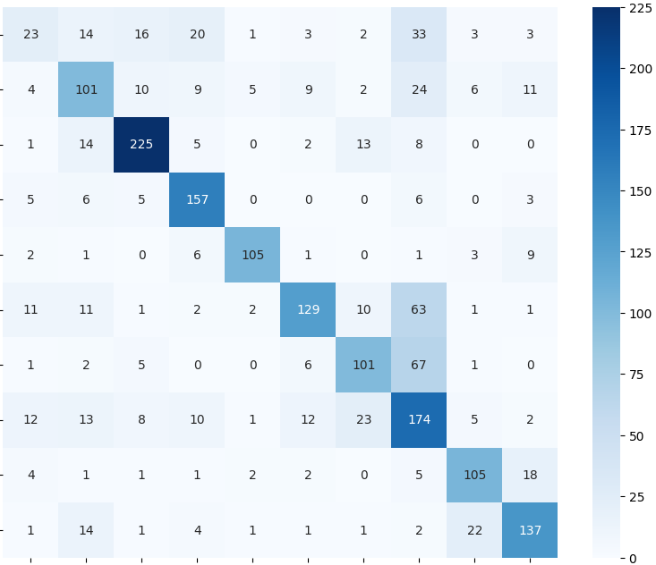
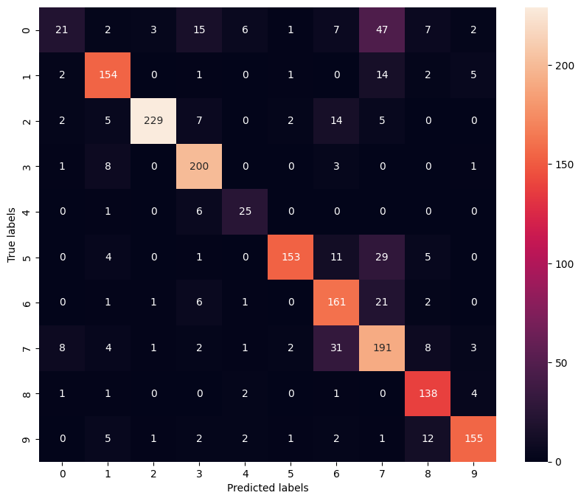
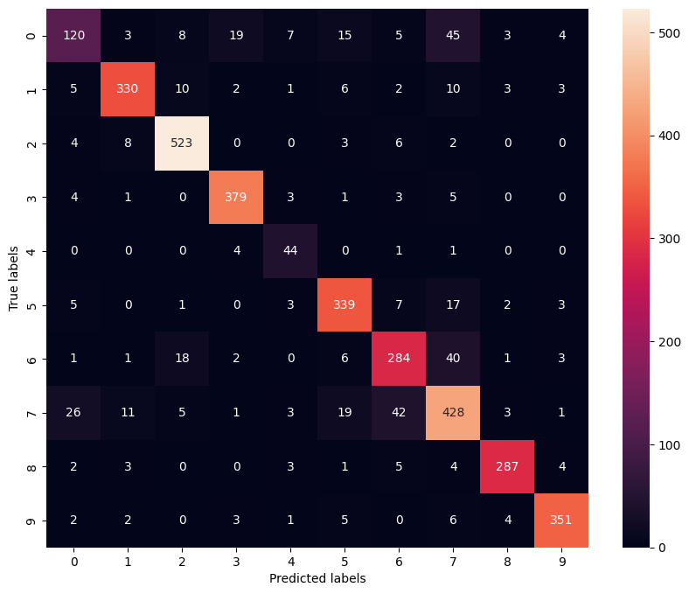
Results: Confusion Matrix
Custom CNN
RestNet50
EfficientNet_B5

Slide 16
04
Conclusion

Slide 17
Discussions
Underscores the crucial role of CNNs in classifying astronomical images (a complex task where traditional methods struggle)
Overcome the challenges and demonstrated by the varied architectures that we built and analyzed
Fine-tuning strategies significantly impacted training duration and computational resource requirements
Strategic use of data augmentation and class rebalancing proved essential in addressing data biases and improving classification accuracy
Maintained high precision and recall across most classes, demonstrating robustness
Implementation of advanced noise reduction technique: denoising autoencoders
Optimize Computational Efficiency: explore more efficient network architectures
Add Explainable AI (XAI) methods to understand and address class confusion
Future Work

Slide 18
Thank you!
Q & A
Contact us:
Corresponding author: Tram Le
Email address: hle12@kent.edu
Department of Computer Science,
Kent State University, US

Slide 19
References
[1] Y. Qian, “Performance comparison among vgg16, inceptionv3, and resnet on galaxy morphology classification,” in Journal of Physics: Conference Series, vol. 2580, no. 1. IOP Publishing, 2023, p. 012009.
[2] G. Wang, “Galaxy morphology classification with densenet,” in Journal of Physics: Conference Series, vol. 2580, no. 1. IOP Publishing, 2023, p. 012064.
[3] N. Premanand, V. Tarun, S. Pawar, D. Jawakar, S. Deepa, J. Jayapriya, M. Vinay et al., “Performance evaluation of convolutional neural networks for stellar image classification: A comparative study,” in 2023 International Conference on Data Science and Network Security (ICDSNS). IEEE, 2023, pp. 1–6.
[4] F. A. S¸ enel, “A hyperparameter optimization for galaxy classification.” Computers, Materials & Continua, vol. 74, no. 2, 2023.
[5] S. Kalvankar, H. Pandit, and P. Parwate, “Galaxy morphology classification using efficientnet architectures,” arXiv preprint arXiv:2008.13611, 2020.
[6] D. S. Team, “Galaxy10 decals dataset,” https://github.com/astroML/Galaxy10 DECals, 2020, accessed: 2020-10-10.
[7] K. He, X. Zhang, S. Ren, and J. Sun, “Deep residual learning for image recognition,” in Proceedings of the IEEE conference on computer vision and pattern recognition, 2016, pp. 770–778.
[8] Y. Bengio, “Deep learning of representations for unsupervised and transfer learning,” in Proceedings of ICML workshop on unsupervised and transfer learning. JMLR Workshop and Conference Proceedings, 2012, pp. 17–36.
[9] A. Krizhevsky, I. Sutskever, and G. E. Hinton, “Imagenet classification with deep convolutional neural networks,” Communications of the ACM, vol. 60, no. 6, pp. 84–90, 2017.
[10] M. Z. Alom, T. M. Taha, C. Yakopcic, S. Westberg, P. Sidike, M. S. Nasrin, B. C. Van Esesn, A. A. S. Awwal, and V. K. Asari, “The history began from alexnet: A comprehensive survey on deep learning
approaches,” arXiv preprint arXiv:1803.01164, 2018.
[11] G. Huang, Z. Liu, L. Van Der Maaten, and K. Q. Weinberger, “Densely connected convolutional networks,” in Proceedings of the IEEE conference on computer vision and pattern recognition, 2017, pp. 4700–4708.
[12] M. Tan and Q. Le, “Efficientnet: Rethinking model scaling for convolutional neural networks,” in International conference on machine
learning. PMLR, 2019, pp. 6105–6114.

Slide 20
Conclusion
In this project, we developed a CNN models for galaxy morphology classification, tailored specifically to the needs of astrophysics and astronomy. Utilizing high-quality data, strategic data augmentation, and transfer learning, we significantly enhanced model performance. Additionally, we have implemented a testing script designed to deploy this model for classifying real astronomical data, further demonstrating its practical applicability and potential to support advanced research in this domain
Future work
Leverage high-performance computing to reduce computational costs and enhance efficiency
Implement advanced noise reduction techniques to improve image quality, significantly boosting model accuracy

Slide 21
Introduction
Classifying galaxy morphology stands as one of the most formidable challenges in astrophysics, demanding advanced techniques to unravel the complexities of the universe's diverse and intricate structures.
Background and Challenge:
Complexity in Classification:
Variability in Galaxy Images: Differences in shape, size, and structure make classification difficult.
Noise and Blurring: Images are often affected by noise and blurring, obscuring crucial features.
Motivation:
Scientific Importance:
Accurate classification of galaxy morphology helps in understanding galaxy formation and evolution.
Provides insights into the structure and composition of the universe.
Technological Advancements:
Leverage recent advancements in machine learning to enhance classification accuracy.
Potential to improve our ability to analyze and interpret large-scale astronomical data.

Slide 22
Workflow
Data
Exploration and Preparation
Model Analysis
Training and Finetune
Evaluation
Understand the data and prepare it for effective modeling
Tailoring CNN Architectures and Transfer Learning
Develop a model capable of making accurate classification
Assess the model's performance with different metrics

Slide 23
Related Work / Survey
Name(s) of Author (Year) | Research Title | Dataset | Methodology and Results | Limitations/Cons
Qian, Y. (2023, September) | Performance comparison among VGG16, InceptionV3, and resnet on galaxy morphology classification | Galaxy10 DECals | Used 3 Classical CNNs InceptionV3 (83.6% accuracy) VGG16 (82.75% accuracy) ResNet50 (80.78% accuracy) | The total parameters of InceptionV3 are about 25 million, which makes it challenging to maintain its remarkable computational efficiency
Wang, G. (2023, September) | Galaxy morphology classification with densenet | Galaxy10 DECals | Used DenseNet-201 and two other methods DenseNet-201 (86% accuracy) VGG16 (79% accuracy) MobileNetV2 (78% accuracy) | DenseNet-201 had a longer training time due to its larger model size
Şenel, F. A. (2023) | A Hyperparameter Optimization for Galaxy Classification | Galaxy10 SDSS | Hybrid CNN and obtain three metaheuristic algorithms GWO (85.2% accuracy) ABC (82.8% accuracy) PSO (80.7% accuracy) | The reliance on metaheuristic algorithms for parameter optimization may involve computational complexity
Premanand, Navneeth, et al. (2023) | Performance Evaluation of Convolutional Neural Networks for Stellar Image Classification: A Comparative Study | Star Galaxy | 3 CNNs Parallel CNN (90.08% accuracy) VGG16 (86% accuracy) ResNet (83% accuracy) | The Parallel CNN model achieved the highest accuracy but with longer training times
Kalvankar, S., Pandit, H., & Parwate, P. (2020) | Galaxy morphology classification using efficientnet architectures | Galaxy Zoo 2 | Fine-tuned architecture using EfficientNetB5 (93.7% accuracy) | The limitations of the datasets used, including potential biases or imbalances

Slide 24

Model 1: Custom-Built CNN
Input(128x128x3)
A foundational approach, utilizing convolutional layers to analyze image features
Split 80% for training and 10% for validation and 10% for testing with Batch size: 32
Using sequential layer stacking:
Input layer
4 Convolutional Layers: with activation function: Tanh for non-linearity to help the model learn complex patterns, with Strides and padding size of 1
Layer 1: 16 filters of size (3, 3): Captures basic, low-level features like edges and simple textures from the input image
Layers 2, 3, and 4: 32 filters of size (3, 3) each: Capture more complex patterns and features, such as shapes and higher-level details
Max Pooling: after each convolutional layer with a kernel size of (2, 2) to downsample the feature maps
Flatten Layer: Flattens the 3D feature maps into a 1D vector to prepare for the fully connected (Dense) layer
Dropout Layers:
First Dropout: 0.25 applied after the Flatten layer to prevent overfitting by randomly setting 25% of the units to zero.
Second Dropout: 0.5 applied before the Dense layer
Fully Connected Layer: with 32 neurons to processes the flattened feature map and learns complex representations. Followed by activation function: Tanh
Output Layer: Using Softmax for Outputs a probability distribution across the classes

Slide 25
Our Workflow
Data
Exploration and Preparation
Model Training and Validation
Model
Evaluation
Summary and report
Understand the data and prepare it for effective modeling
Develop a model capable of making accurate classification
Assess the model's performance using the testing set and evaluation metrics
Document the project, findings, and insights, and communicate results
Description of Task Roles and Contributions
 | Tram Le | Thu Nguyen | Nickson Ibrahim Makama | Thanyaporn Noiplab
Individual Task | Research Transfer learning model, Developed, Trained & Evaluate EfficentNet_B5 & ResNet50 and GradCam to understand the model acting | Data Preprocessing Help improve performance of the custom model, organize codes and print results | Implemented & Trained custom model, Testing, Video | Research / Compare Papers & suggest efficient model Architecture Coordinate meetings Debug, comment all models
Joint Task | Choose the project topic Propose different Models based on research Experiment on different Architectures Prepare the Powerpoint slides Project Presentation Write the project report

Slide 26
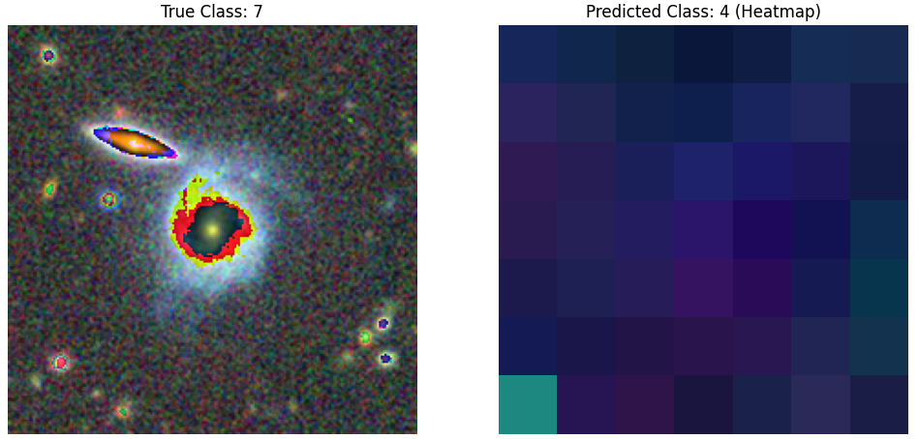
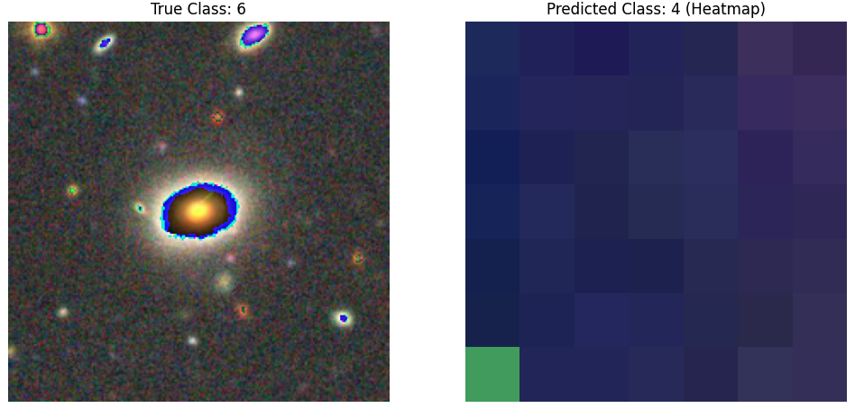
Model 2: Interpret model with GradCam
Deep end-to-end model is difficult to interpret the model and how it makes that decision on prediction
Model often confuse class 5, 6 and 7, potential misclassification
The colored overlay on true class highlight the regions the model focus the most
Heatmap for prediction class show attention in the bottom left corner, indicating the model not focus on relevant features for true class. Hence, cause confusion between classes

Slide 27
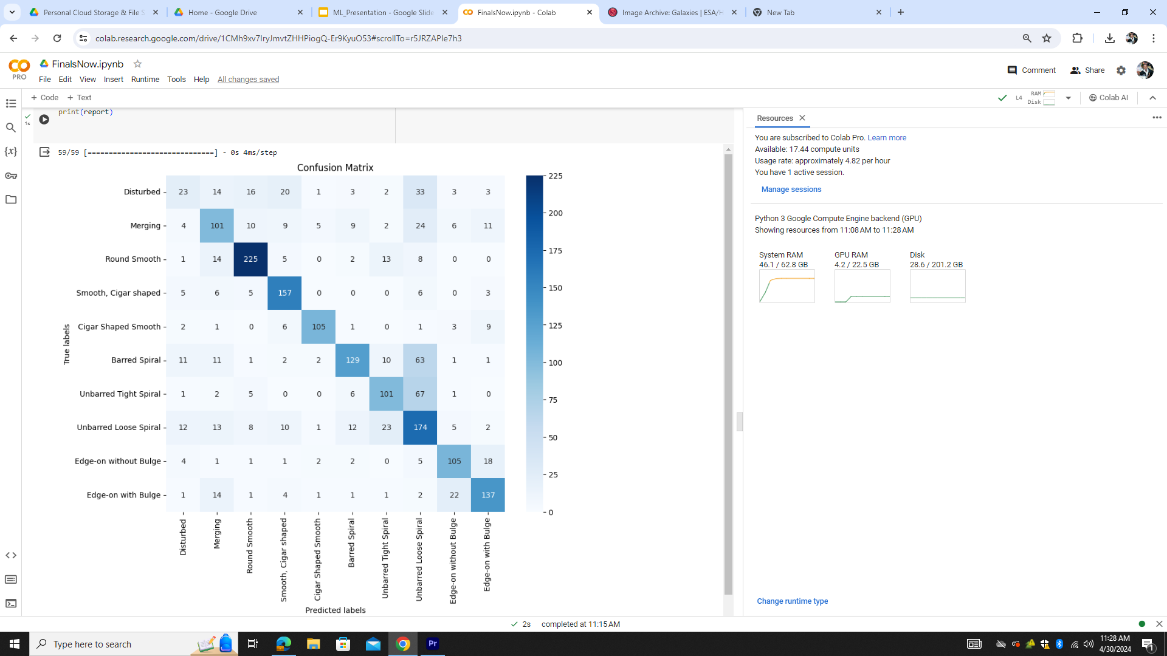
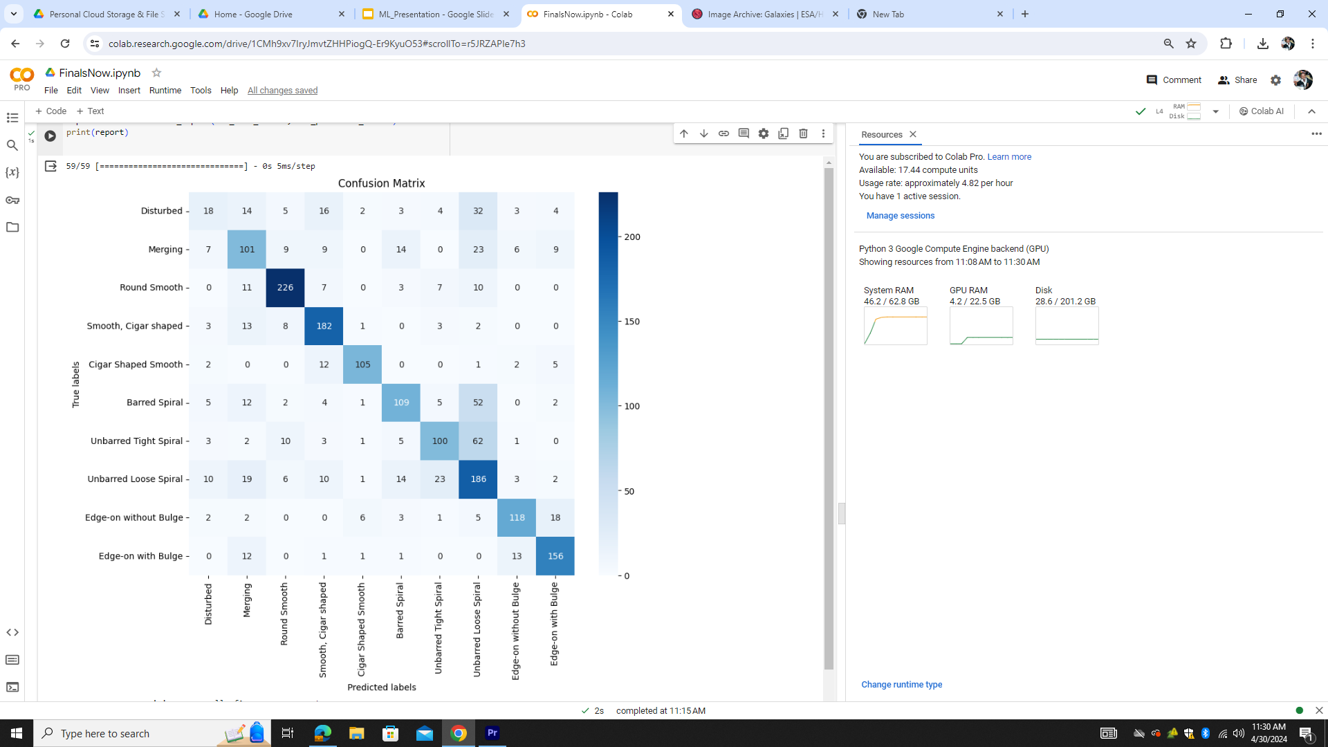
Model 1: Custom model: Result
Training Accuracy: 67%
Testing Accuracy: 70%

Slide 28
Data Preprocessing: OLD
2. Data Augmentation
Increase Accuracy: +10~12%
Name | Range | Effect
Resize Images | 128 x 128 pixels | ­­↑ 7% Accuracy
Rotation | 90 | ↑ 2% Accuracy
Horizontal Shift | 20% | ↑ 2% Accuracy
Vertical Shift | 20% | ↑ 1% Accuracy
Horizontal Flip | True | ↑ 2% Accuracy
Zoom in/out | 20% | ↑ 1% Accuracy
Final Effect of Data Preprocessing: +15%

Slide 29
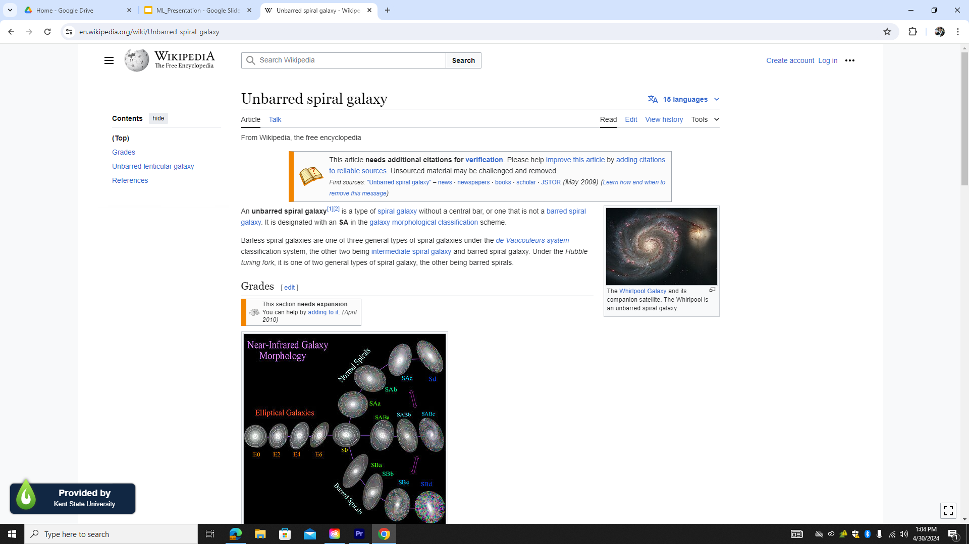
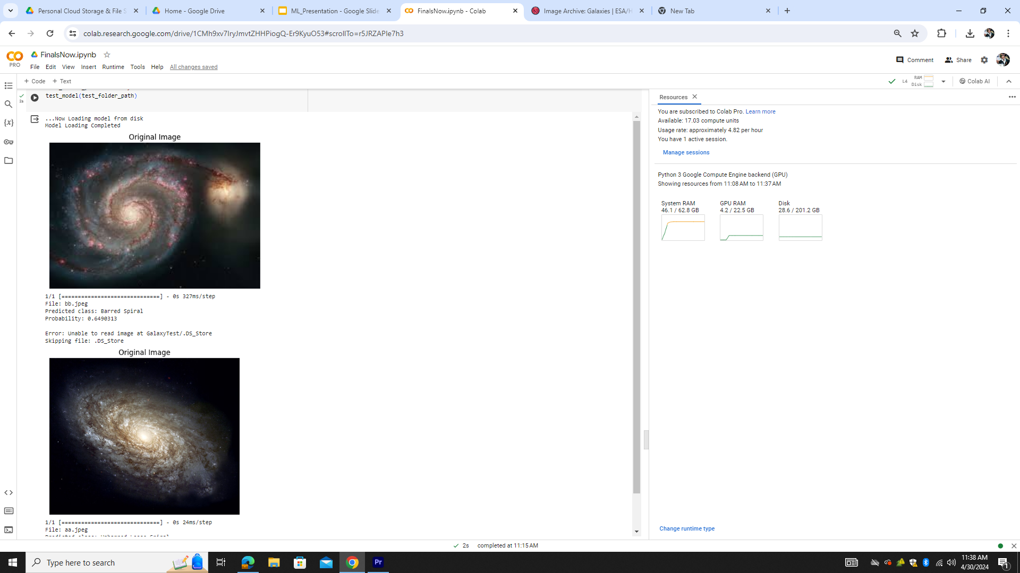
Model 1: Testing on real data
Create a video that predict label automatically

